Slide 1
Professional Skills
Interviews

Slide 2
Module objectives
After completing this module you will be able to:
Prepare yourself for both face to face and telephone interviews
Create a good first impression
Identify your skills and strengths and talk about them
Answer typical interview questions
Demonstrate suitable interview behaviour

Slide 3
Face to Face Interviews
Your interview is a meeting between a client and a consultant.
The client is assessing whether the consultant can do the job and is the correct team fit.
The consultant is promoting their skills and strengths.

Slide 4
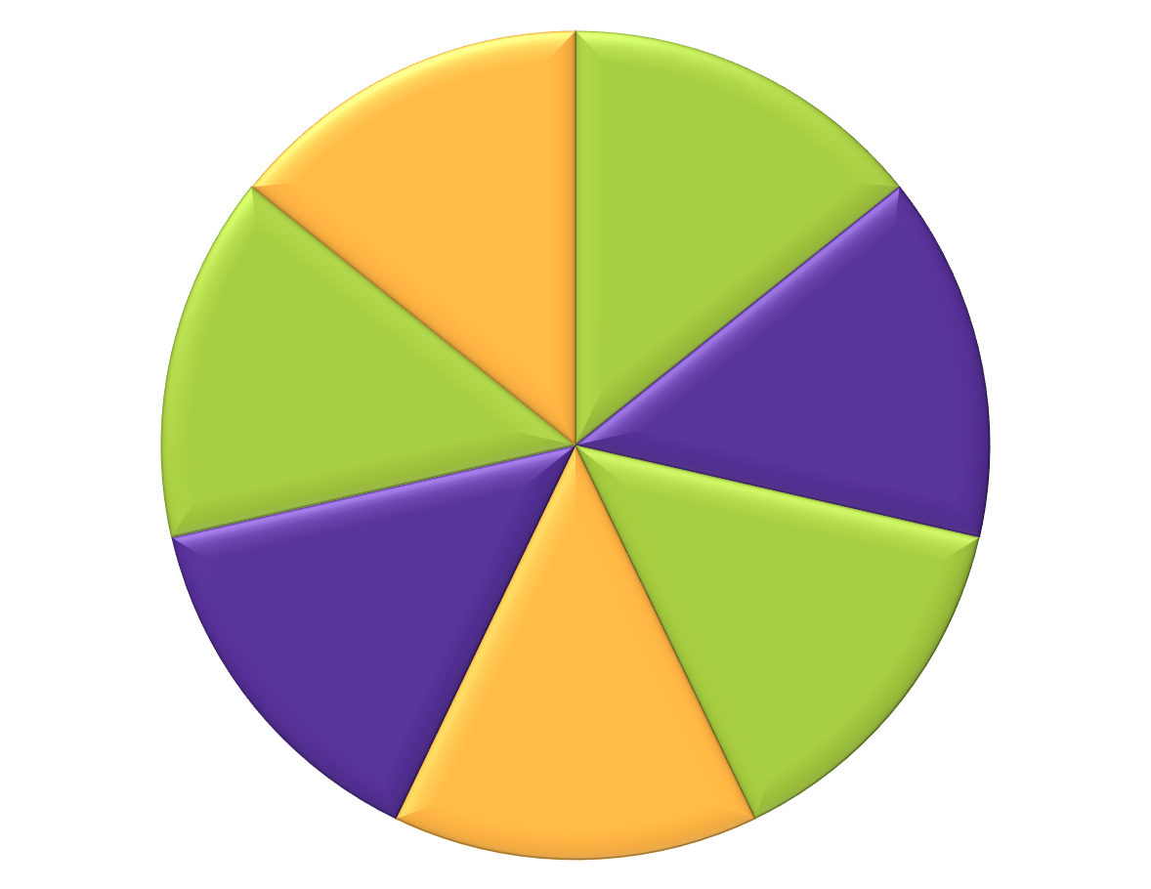
What our clients look for:
Enthusiasm
Professionalism
Commercial Awareness
Commitment
Team Fit
Ability to do job
Good
Communication
Skills

Slide 5
Face to Face Interview - Preparation
Exercise (5 minutes)
In your groups
Discuss how you would prepare for an interview and present your findings

Slide 6

Face to Face Interview - Preparation
Research the organisation
Research the opportunity
Identify your skills and your strengths and be able to talk about them
Prepare your questions

Slide 7
Identify Skills and Strengths
Exercise (15 minutes)
In Pairs
Help your partner identify their skills (technical, numerical etc.) and their strengths (communication, problem solving etc.)
Be prepared to talk about them and provide an example of when you have used them

Slide 8
Skills and Strengths
Use STAR technique
  Situation - where were you
  Tasks - what were you doing
  Actions - what did you do
  Results - what was the outcome

Slide 9
Skills and Strengths Example
Skills:
Change Management
Process Management
Supplier and Stakeholder Communication and Management
Finance Management
Customer – Client Relations
Strengths:
Collaborative Working
Team Work
Leadership
Coaching and mentoring
Strong work ethic

Slide 10
Demonstrating Skills and Strengths using STAR technique
I led a weekly/bi-weekly supplier meetings to ensure one single source of truth was available within the data presented in the Change Logs. I would also review the Change Process to make sure everyone fully understood it and at the same time identify any gaps.
In one meeting the Supplier disagreed with an aspect and/or activity of the process and wasn’t content in implementing it as part of business as usual. In order to resolve this, I encouraged the supplier to explain their concerns and any suggestions they had. Through this I understood the issue and emphasised that we needed to collaboratively work together to ensure that both the Authority and the Supplier were satisfied with the end result.
I set up a further workshop to go through the process in more detail and work through examples with them. This proved to be a successful method as the Supplier was content with the process as a whole once I walked them through it.

Slide 11
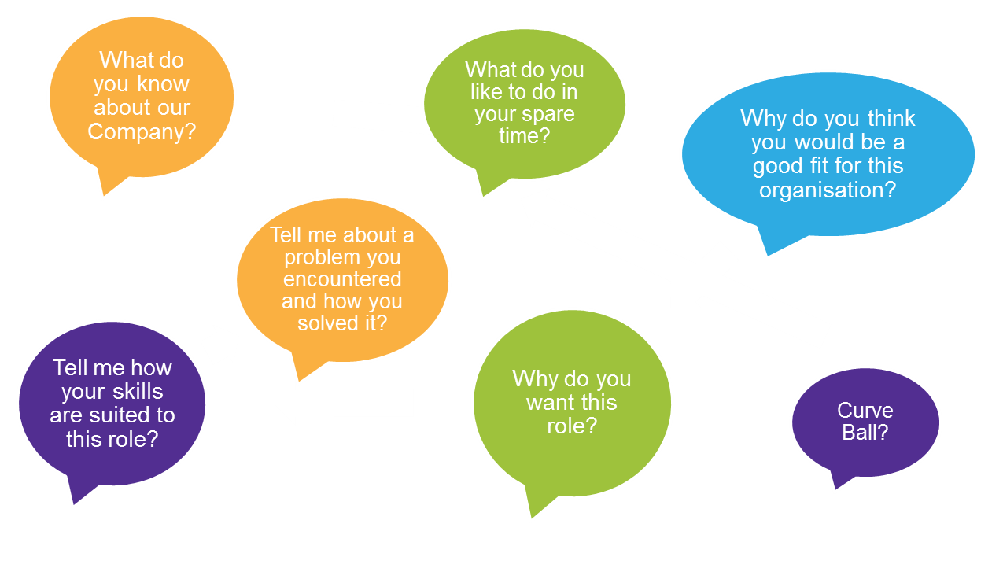
Typical Interview Questions
Notes:
These are the key areas of questioning that you can expect to experience in an interview scenario, regardless of role or Client.
The way the question is framed will be what is indicative of the role or area of business you are being considered for.

Slide 12

Answering Questions
Make sure you listen to the question; if unsure, ask if the client could rephrase the question.
    Be clear and concise
    Keep to the point
    If you think you are ‘waffling’, stop talking and ask the client “have I answered your question or would you like more detail”
    Be enthusiastic and interested
Notes:
Emphasise that the focus of your answers should be around the ‘A’ for action (helpful to remember it as ‘A’ for approach, as the emphasis in your example should be on what YOU did).

Slide 13
Putting it into practice
Exercise (10 minutes)
Prepare a response to one of the following :-
  Describe how you explained something technical to a non-technical person
  Give an example of a time when you had to meet a tight deadline and how you coped
  Give me an example of when you worked in a team, what was your role and contribution to the team
  Describe a situation where you had to deal with conflicting priorities

Slide 14

Body Language and Behaviour
Firm handshake
Good posture – don’t fold your arms
No fidgeting
Smile and maintain eye contact
Introduce yourself
Focus on the positive
Be enthusiastic
Show interest

Slide 15
Closing the Interview
    - Can you tell me about the project I will be working on?
    - What will I be doing in the first few weeks?
    Can you tell me about the team I will be joining?
        Role expectations
        Project plans for the year
        Career opportunities
    Thank client for giving you the opportunity

Slide 16

Telephone Interview
As there is no visible body language between you and the client:
Smile on the phone
Vary tone of voice
Listen carefully
Use phrases to indicate you are thinking – avoid silence
      I am just taking a moment to think about your question
Notes:
Enthusiasm
smile as you speak
stand up when you talk
project your answers
no ums and errs
listen carefully to the other person and ask questions to clarify
Vary your tone of voice (mono tone is boring to listen to so avoid this)
Thinking time to answer questions is just silence over a telephone so you need to use phrases to let the interviewer know that you are thinking. E.g. that’s a great question just let me think about that for a moment

Slide 17
Module Recap
Prepared yourself for both face to face and telephone interviews
Created a good first impression
Identified your skills and strengths and talked about them
Answered typical interview questions
Demonstrated suitable interview behaviour

